Slide 1



DHANALAKSHMI SRINIVASAN ARTS AND SCIENCE (CO-EDUCATION) COLLEGE ,MAMALLAPURAM

Slide 3
INDIA’S AGRICULTURAL CROP PRODUCTION ANALYSIS (1997-2021)
SUBMITTED BY:
ASWINI .S 222109541
GEETHANJALI .V 222109542
PAVITHRA .S 222109543
SWETHA .K 222109544
VANITHA .P 222109545
GUIDED BY:
Mrs. A. Ananthi M.Sc., M.Ed.,
Assistant Professor,
Department of Mathematics.

Slide 4
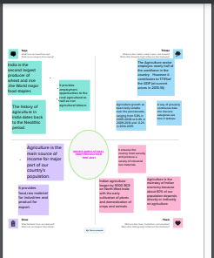
EMPATHY MAP

Slide 5
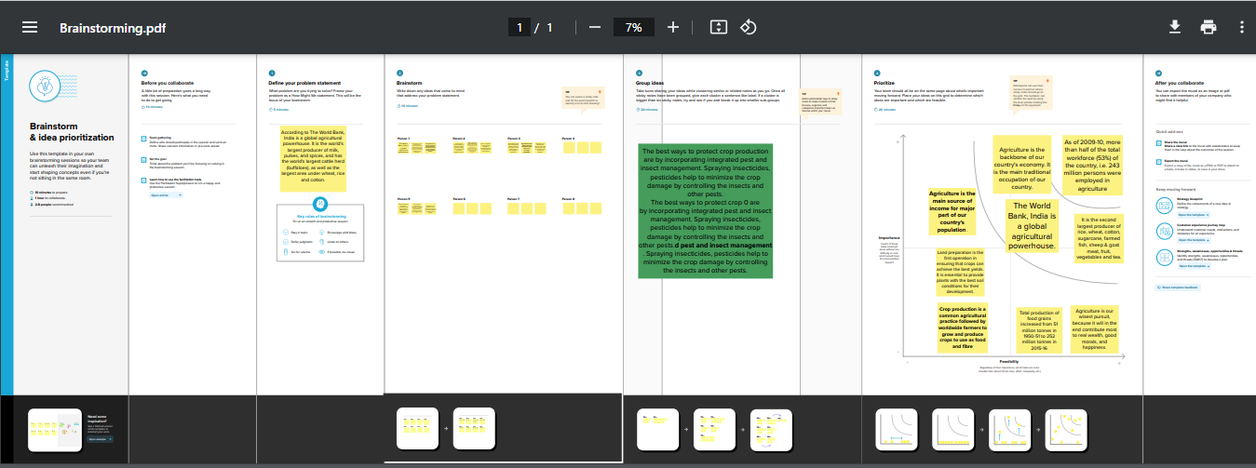
BRAINSTORMING MAP

Slide 6
QUESTIONS
Difference between Area Vs Production
Which crop is the most common choice for agriculture in India?
Which season yield more crop production in India?
Mention the Statewise Agricultural Land?
Mention the Season wise crop production in India?

Slide 7
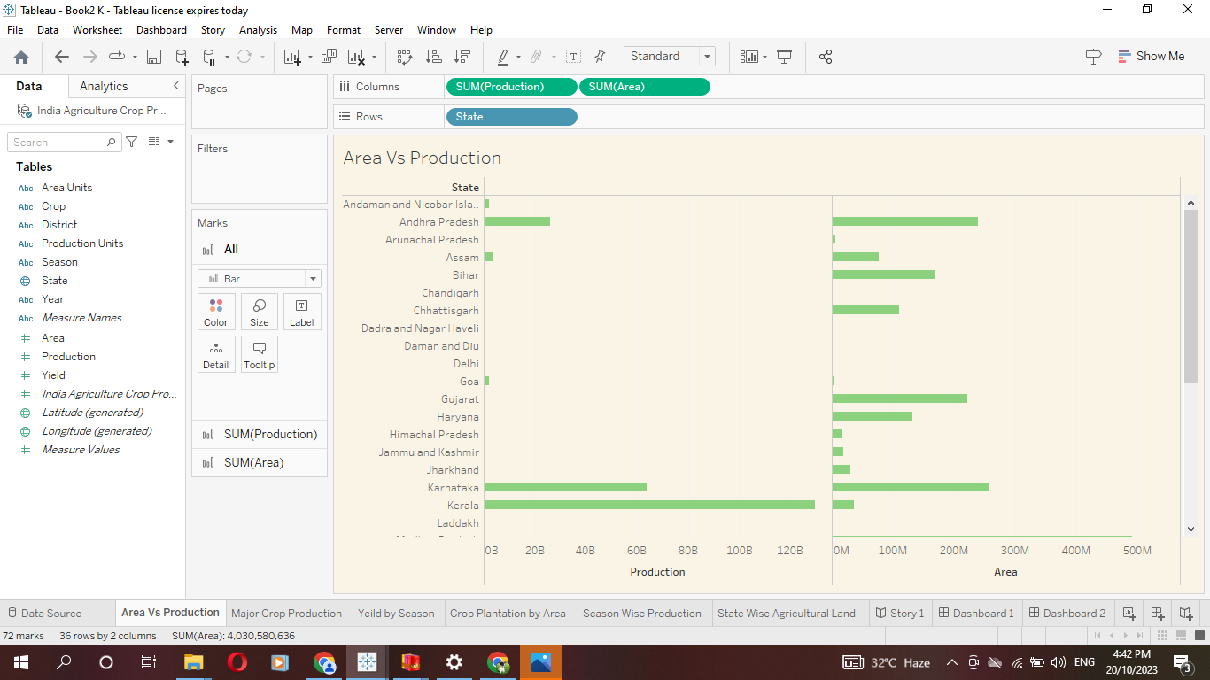

Slide 8
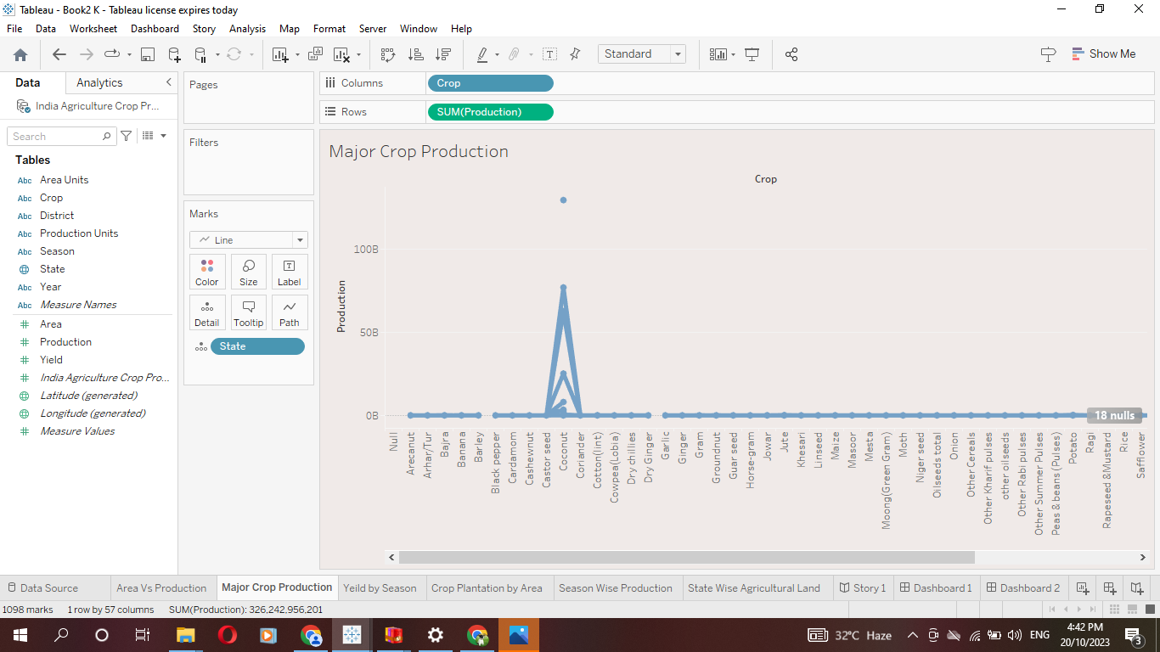

Slide 9
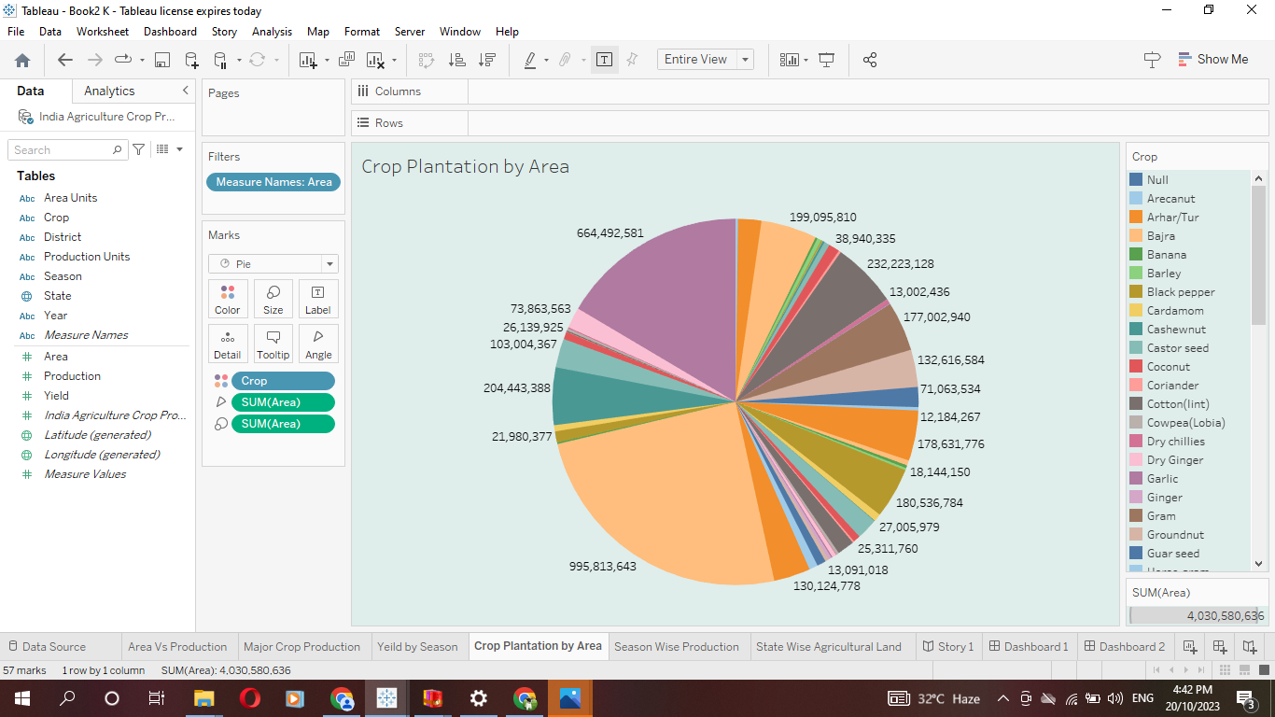

Slide 10
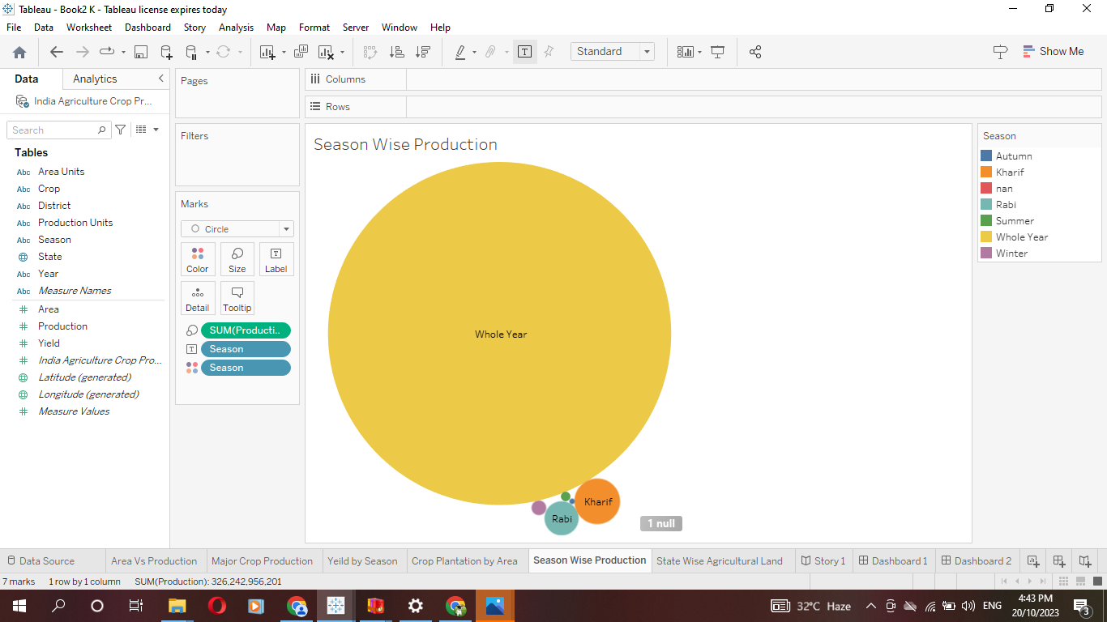

Slide 11
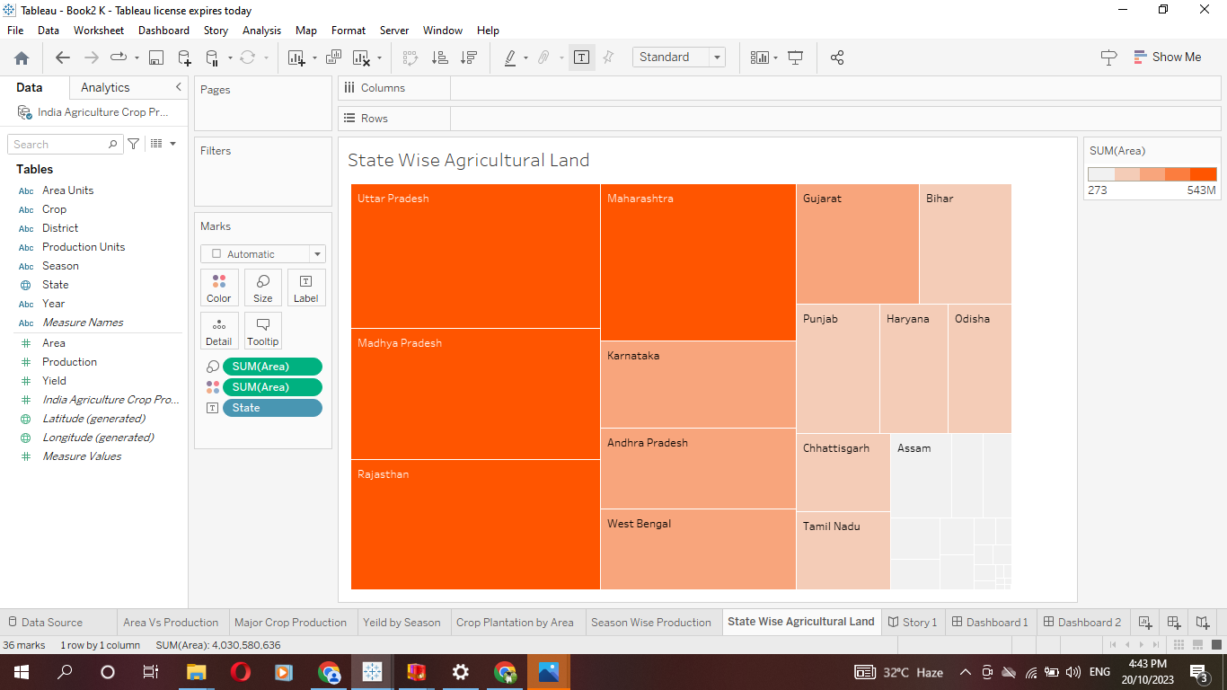

Slide 12
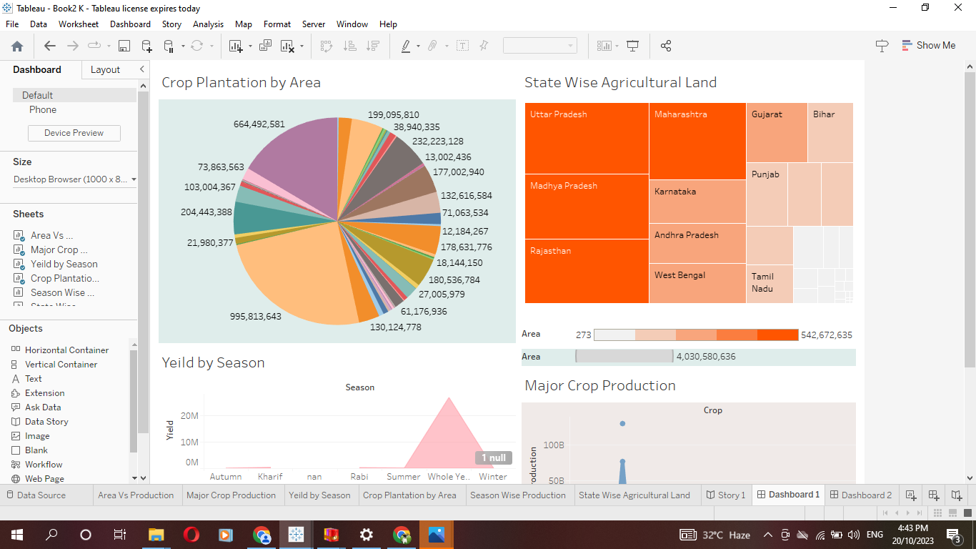
Dashboard 1

Slide 13
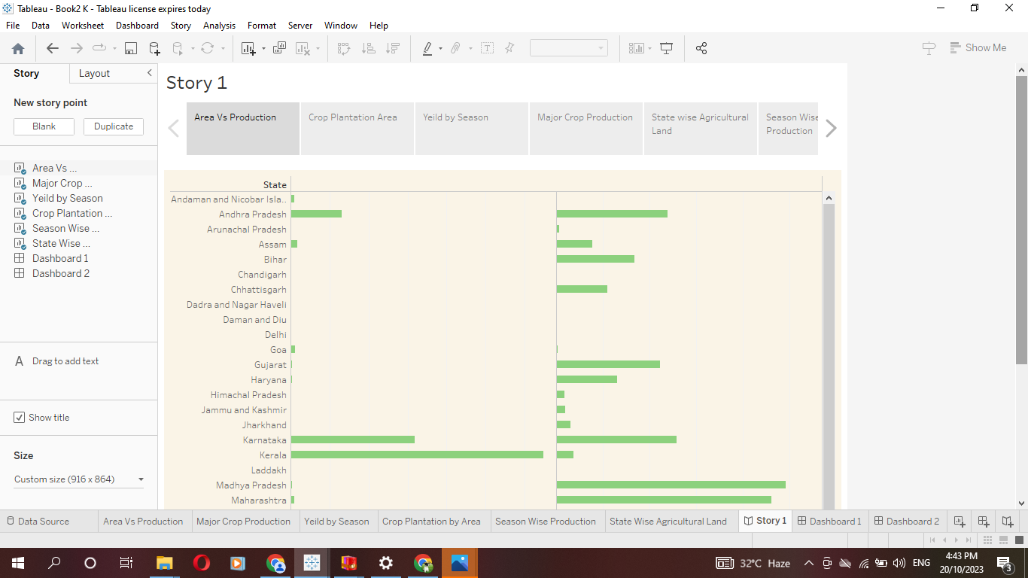

Slide 14
THANKING YOU

